Slide 1

Title
SYNOPSIS PRESENTATION
THESIS DEFENCE PRESENTATION
February 28 2023
PRINCIPAL INVESTIGATOR
Abc
MPhil Trainee, MBBS
Dow University of Health Sciences
SUPERVISOR:
Dr.Abc
MBBS, FCPS
Assistant Professor
Dow Dental College
CLINICAL SUPERVISOR:
Dr. Acc
MBBS, FCPS
Head of Department
Dept. of Abc
Dr. Ruth K. M. Pfau, Civil Hospital Karachi

Slide 2
Disease (1-3)
Work-related musculoskeletal disorder.
Median nerve Entrapment of upper limb.
Mono-neuropathy of upper limb.

Slide 3
Factors causing Disease
Abc
DFg

Slide 4

INTRODUCTION
F>>M
Middle age female
1.5/1000 male

Slide 5
INTRODUCTION
Treatment options
(5-8)
agents
vdc
Avc
therapy

Slide 6

PREVALENCE (9-10)
5.8%
3.1%
NETHERLAND
USA
7 % – 16%
UNITED KINGDOM

Slide 7

PREVALENCE (11)
7% - 19%
PAKISTAN

Slide 8
LITERATURE REVIEW(13-17)
Talebi GA et.al. , 2015
Abc Title
Method
Study Design
30 Patients
Group vcccc
Outcome Measure
VSAS, DSD
Ismail. F and colleagues. 2015
Abc Title
Method
Study Design
30 Patients
Group vcccc
Outcome Measure
VSAS, DSD
Pratelli. E et.al., 2017
Abc Title
Conclusion
asds
Conclusion
asds
Method
Study Design
30 Patients
Group vcccc
Conclusion
asds
Outcome Measure
VSAS, DSD

Slide 9
LITERATURE REVIEW
Talebi GA et.al. , 2015
Abc Title
Method
Study Design
30 Patients
Group vcccc
Outcome Measure
VSAS, DSD
Ismail. F and colleagues. 2015
Abc Title
Method
Study Design
30 Patients
Group vcccc
Outcome Measure
VSAS, DSD
Pratelli. E et.al., 2017
Abc Title
Conclusion
asds
Conclusion
asds
Method
Study Design
30 Patients
Group vcccc
Conclusion
asds
Outcome Measure
VSAS, DSD

Slide 10
RESEARCH OBJECTIVE
ads

Slide 11
RATIONALE (18)
Avc

Slide 12
SIGNIFICANCE
Acv

Slide 13
MATERIALS AND METHODS
STUDY DESIGN
SAMPLING METHODS
SAMPLE SIZE
STUDY DURATION
STUDY SETTING
Dr. Ruth K. M. Pfau, CHK (medicine ward)
A single- blinded, randomized-controlled trial
6 Months after synopsis approval
Non-probability, purposive sampling technique.
2 Groups, 30 Patients in each Group. Total Sample Size = 60

Slide 14
MATERIALS AND METHODS
INCLUSION CRITERIA
ad
EXCLUSION CRITERIA
asd
ds
Age: 18-50 years
Both gender patients
ass
sd
sd
dsd

Slide 15
STUDY GROUPS
GROUP A
ads
GROUP B
asd
dds
asd
sad

Slide 16
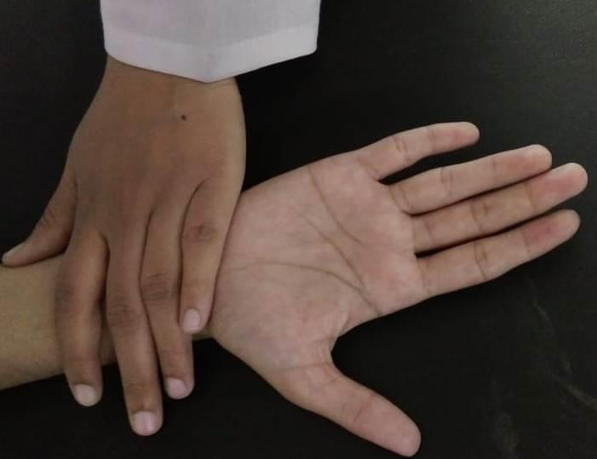
Group A: Avsc TECHNIQUE
Figure:2 aa
Figure:3 ff
Figure: 4 sad
Figure: 5asd

Slide 17
Group B: Avsc TECHNIQUE
Figure:2 aa
Figure:3 ff
Figure: 4 sad
Figure: 5asd

Slide 18
OUTCOME MEASURE: (20-22)
Visual Analogus Scale (VAS):
It is a scale that is typically used to evaluate asds
Visual Analogus Scale (VAS):
It is a scale that is typically used to evaluate asds
asdsd
Visual Analogus Scale (VAS):
It is a scale that is typically used to evaluate asds
asdsd
asdsd

Slide 19
OUTCOME MEASURE: (20-22)
Visual Analogus Scale (VAS):
It is a scale that is typically used to evaluate asds
Visual Analogus Scale (VAS):
It is a scale that is typically used to evaluate asds
asdsd
Visual Analogus Scale (VAS):
It is a scale that is typically used to evaluate asds
asdsd
asdsd

Slide 20
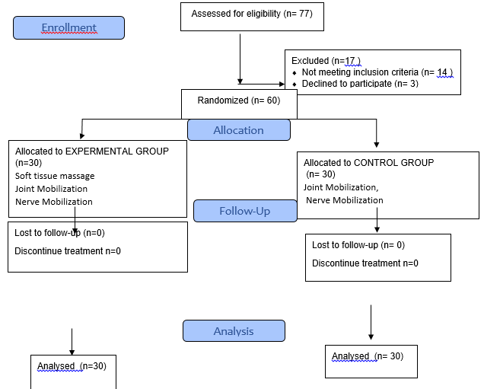
CONSORT

Slide 21
DATA COLLECTION PROCEDURE
1) Screened by a consultant Physiatrist
2) Based on inclusion and exclusion criteria
3) Patient recruited
5) Randomly allocated into Group A and Group B.
4) Informed consent
6) Assessment through VAS at baseline & after six weeks
7) Data recorded and analyzed on SPSS 27

Slide 22

STATISTICAL ANALYSIS
IBM-SPSS version 27.0 was used to record and analyse the data. Counts and percentages were recorded for baseline characteristics and results on the dad. Within group comparison was made using paired sample –test, between group comparisons was done using independent sample t-test. The statistical normality of the data was evaluated by using the Shapiro-Wilk test. Pearson Chi Square test was used to assessed the association on qualitative outcomes of scales. Statistics were considered significant for P-values less 0.05.

Slide 23
RESULTS
There were 33 patients with mean age of 12.1 , (30 in each group)
22 were male patients
00 were female patients

Slide 24
RESULTS

Slide 25
DISCUSSION
Adsad

Slide 26
DISCUSSION
asds

Slide 27
CONCLUSION
Afsc

Slide 28
CLINICAL TRIAL REGISTRATION
This study has been registered in Clinical trial.gov
ClinicalTrials.gov Identifier: NCT05465512

Slide 29
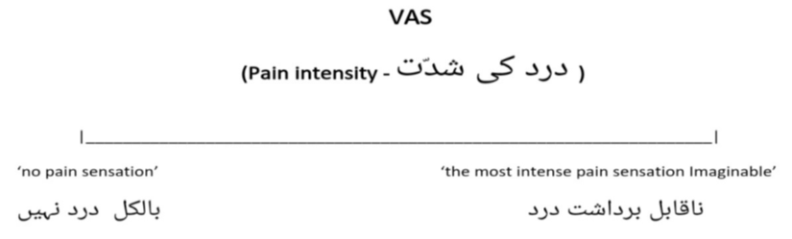
STUD VARIABLES
APPENDICES

Slide 30
REFERENCES
1. acc
2. acc

Slide 31


